Slide 1
HW#7
3-Layered Model
Jacob & Vivek
2nd April 2020

Slide 2
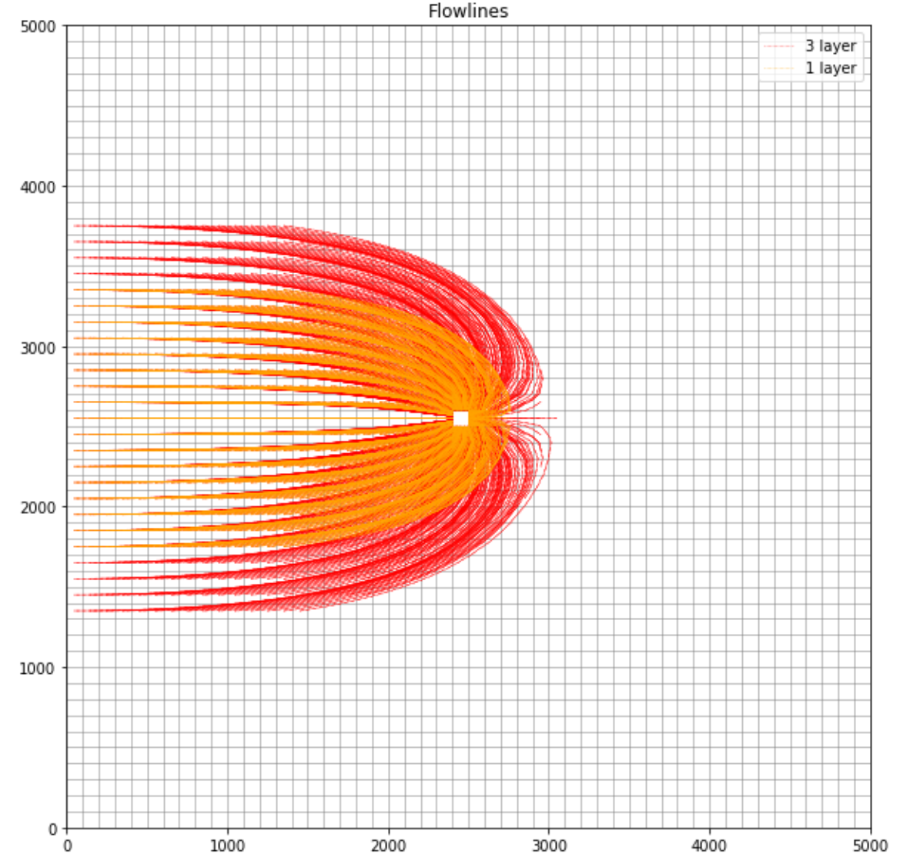
Self Check
Larger capture zone for 3-layered model
Problem initializing? “Layercelldivision” = ?
Smaller capture in Self-Check solution?
Kxy = 0.001

Slide 3
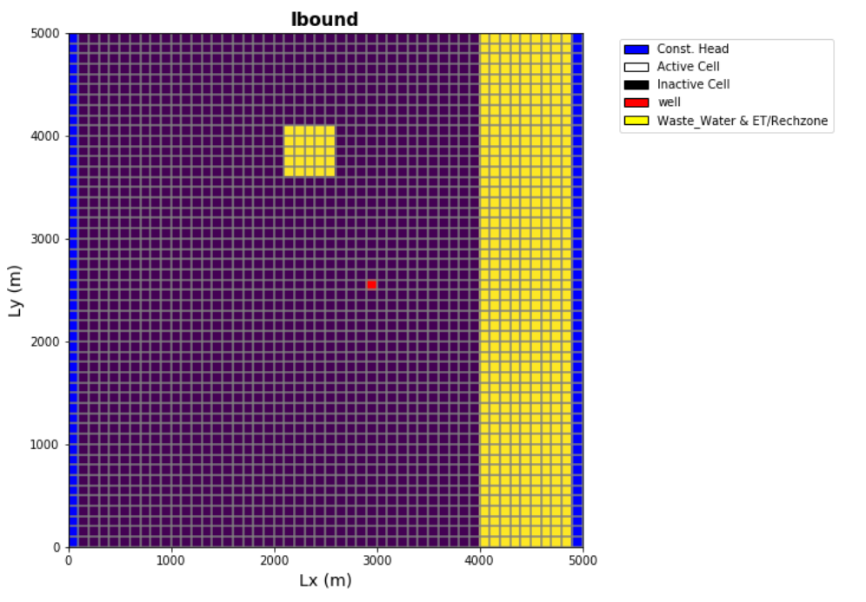
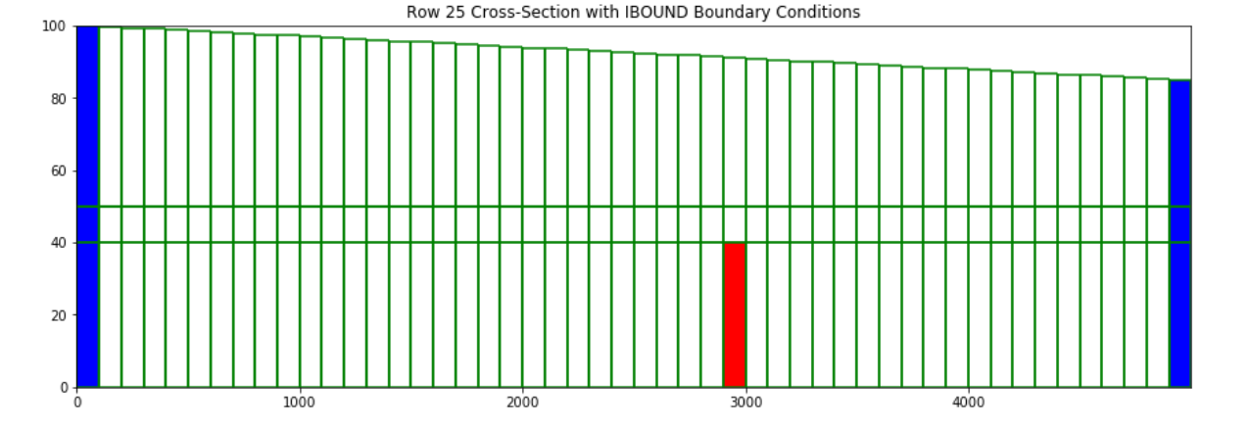
The Set-up

Slide 4
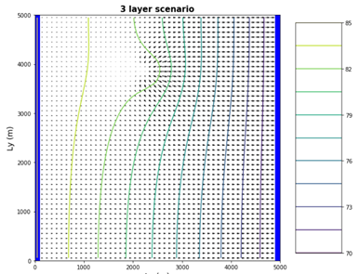
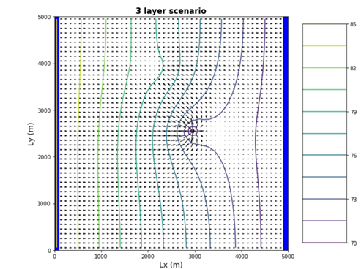
Is the reclaimed water being captured?
Heads in the top layer Heads in the middle layer

Slide 5
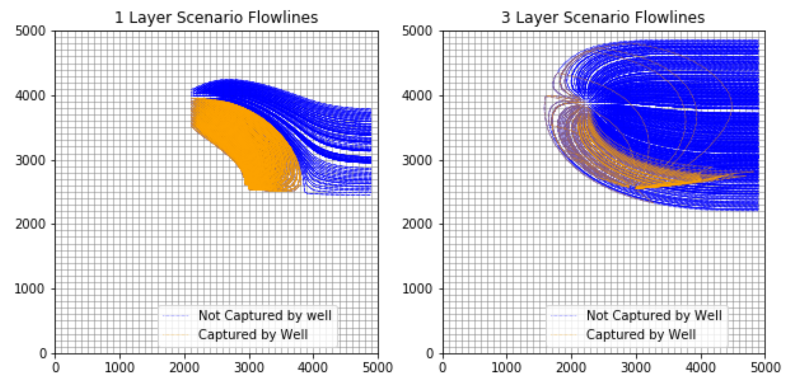
Is the reclaimed water being captured?

Slide 6
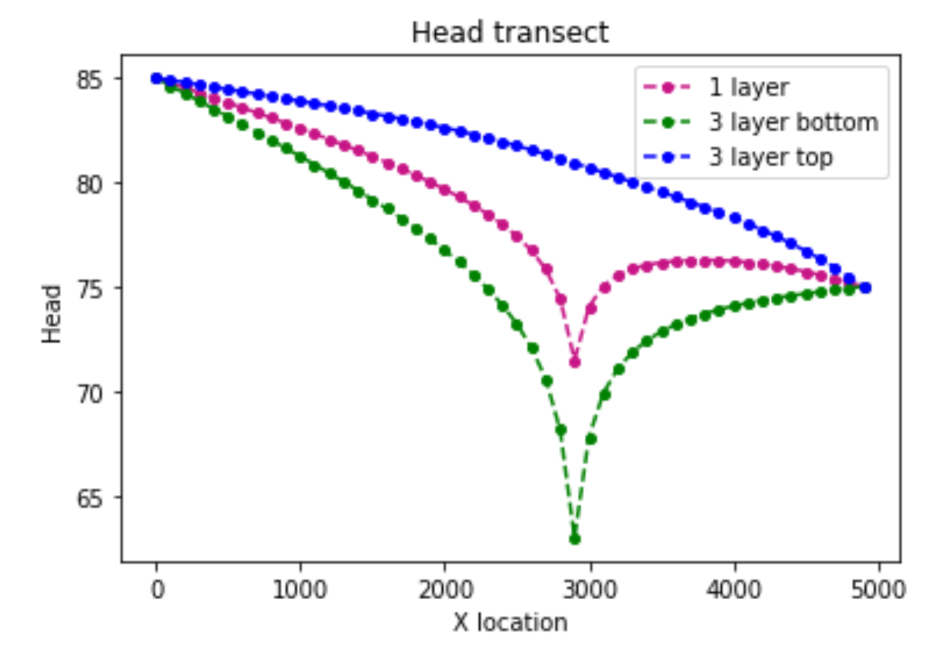
Head transect at the well row

Slide 7
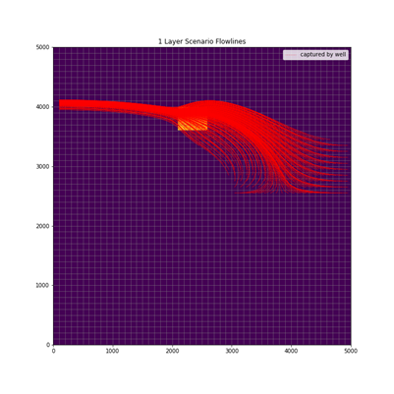
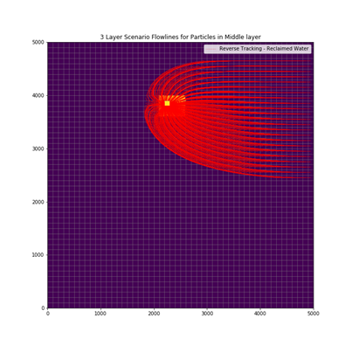
Reverse Particle Tracking for Reclaimed Water?

Slide 8
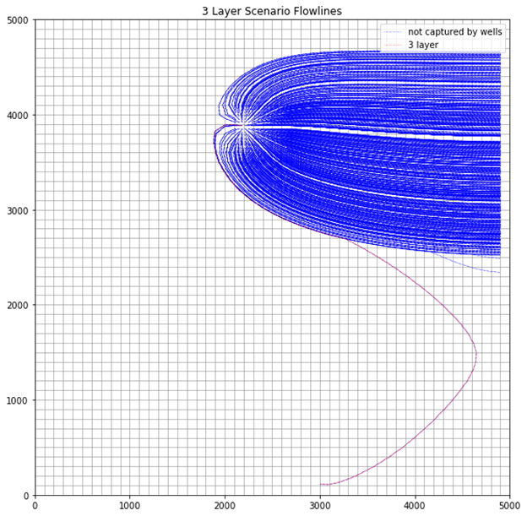
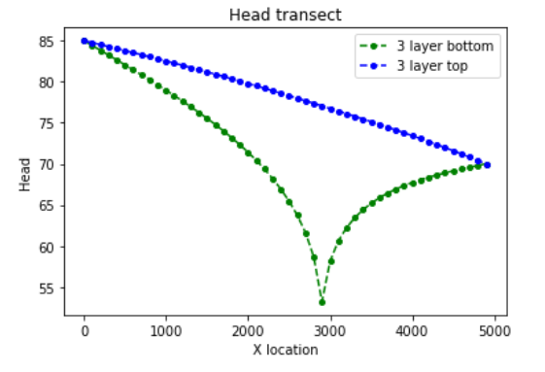
Change Well Position scenario
Wellloc = (3000,1) :Even when y = 1; 1 particle is still being capture by well

Slide 9
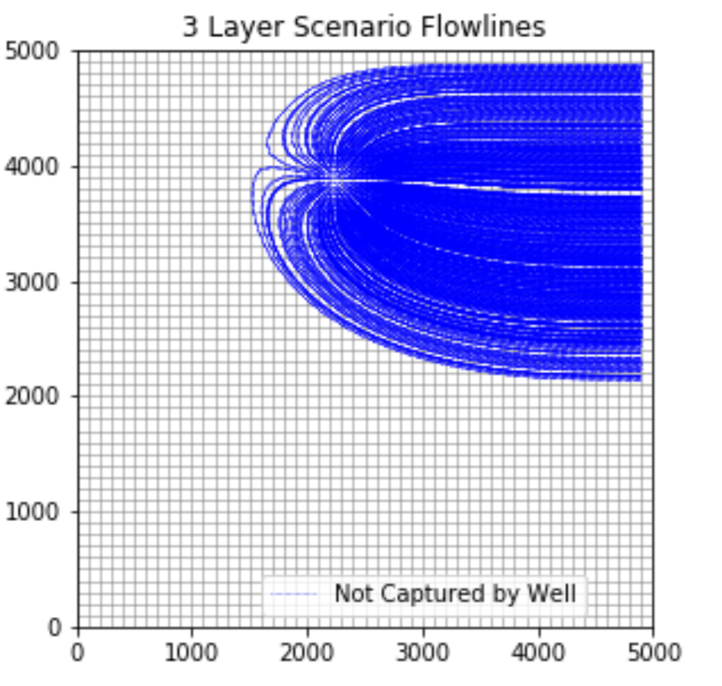
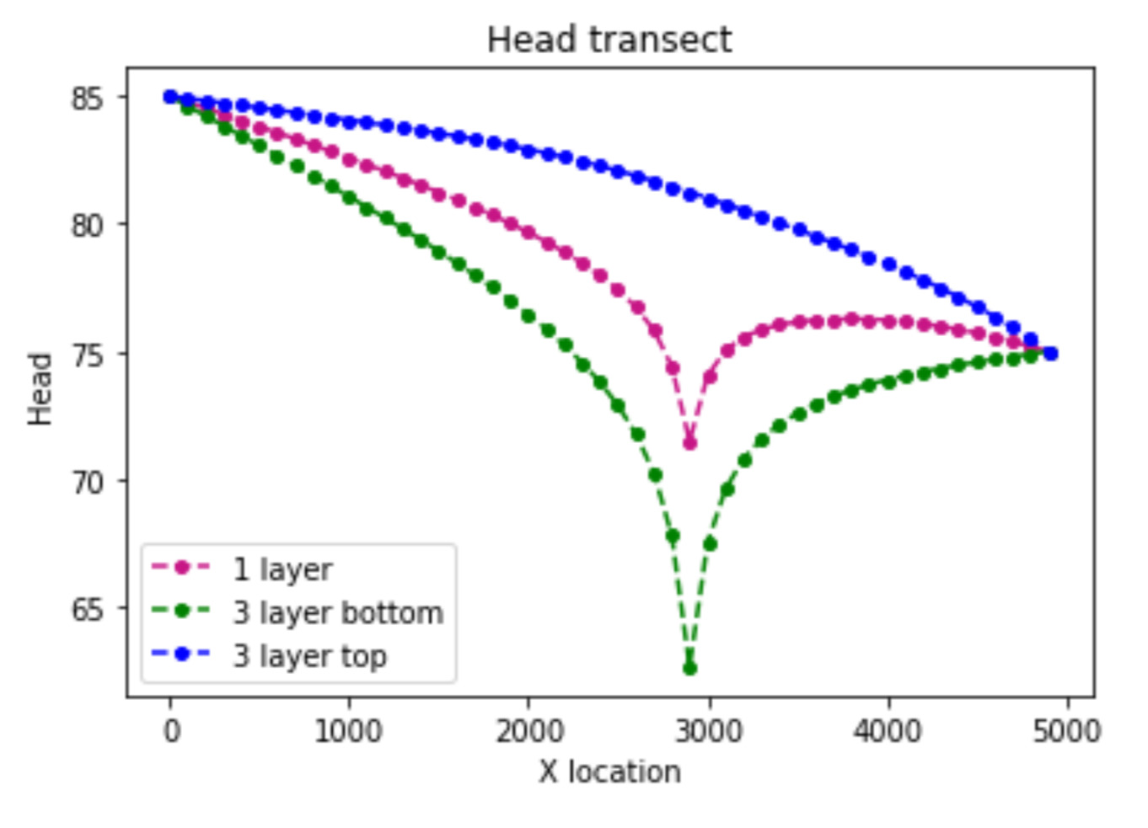
Change Hydraulic Conductivity
K (midlayer)= 0.000001

Slide 10

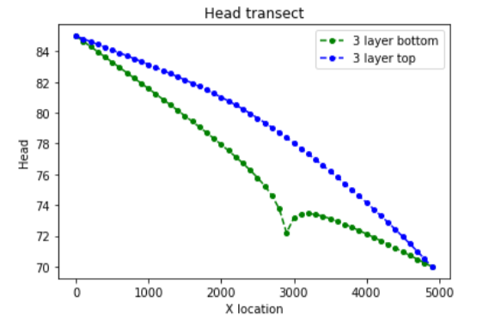
Change Well Pumping Rate
Pumping = 200

